Slide 1

Seasonal Agriculture Performance Analysis
Name: Muthumenen M
Dhanalakshmi Srinivasan University - Trichy
AICTE STU ID : STU6a1e60843698c1780375684

Slide 2

PROBLEM STATEMENT
Agricultural activities are influenced by seasonal variations in environmental conditions, farming practices, resource availability and market conditions. As a result, agricultural performance may differ from one season to another. However, raw agricultural data does not clearly explain how agricultural performance changes across seasons or what patterns can be observed in different seasonal conditions. The problem is to analyze the given agricultural dataset and investigate seasonal differences in agricultural performance by identifying meaningful patterns, trends, relationships and variations within the available data.

Slide 3
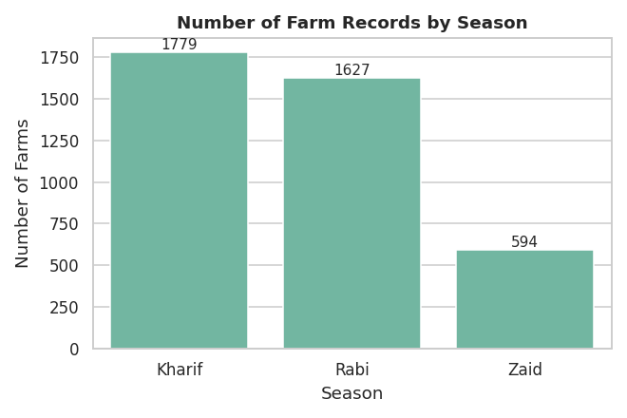
Project Description This project analyzes 4,000 farm-level agricultural records spanning three cropping seasons (Kharif, Rabi, Zaid), 8 Indian states and 8 crops, to investigate how agricultural performance changes across seasons. Using Python-based data analytics, the dataset was audited, cleaned, and explored to uncover seasonal patterns in yield, production, profitability, water efficiency, and disease/pest risk. Environmental conditions, resource usage, and irrigation methods were analyzed for their relationship with outcomes, using appropriate statistical tests (ANOVA, Kruskal-Wallis, correlation, chi-square; alpha = 0.05). The project delivers a fully executable Jupyter Notebook, a cleaned dataset, and a professional report with evidence-based conclusions and data-driven recommendations for seasonal agricultural planning.

Slide 4
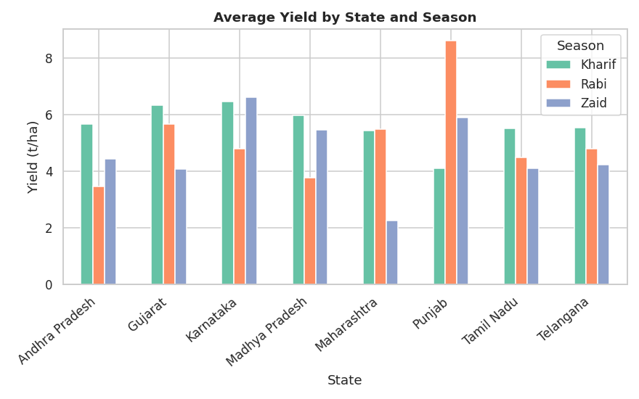

WHO ARE THE END USERS?
State agriculture department officials tracking regional performance
Farmers and farmer cooperatives choosing crops and irrigation methods per season
Agri-finance and insurance providers assessing seasonal risk and profitability
Agricultural researchers and students studying seasonal performance patterns
VOIS AICTE evaluators reviewing this internship major project

Slide 5

Technology Used
pandas & numpy - data cleaning, aggregation, computation
matplotlib & seaborn - statistical visualizations (19 charts)
scipy - hypothesis testing (ANOVA, Kruskal-Wallis, Pearson/Spearman, chi-square)
scikit-learn - standardized linear regression on yield drivers
Jupyter Notebook - primary analysis deliverable (31 sections, executed end-to-end)
Microsoft Excel, Word & PDF - cleaned dataset and report deliverables

Slide 6
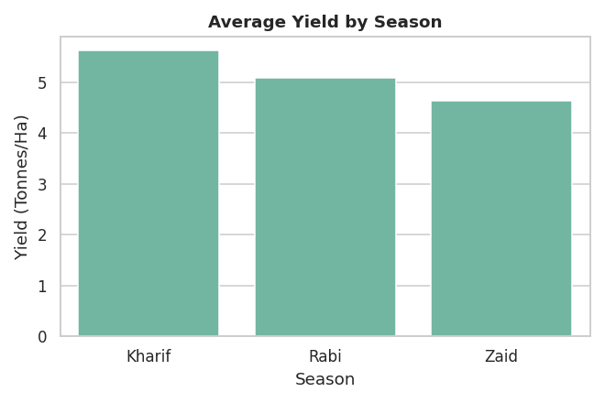
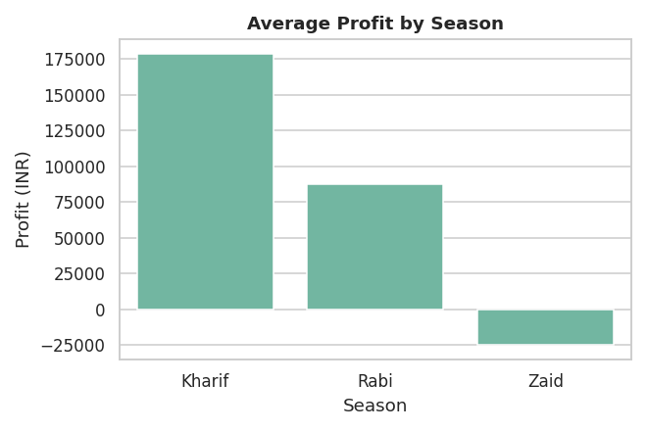
RESULTS - Seasonal Performance Overview
Kharif leads on average yield (5.63 t/ha) and average profit (INR 178,915); Zaid is weakest, with a negative average profit.

Slide 7
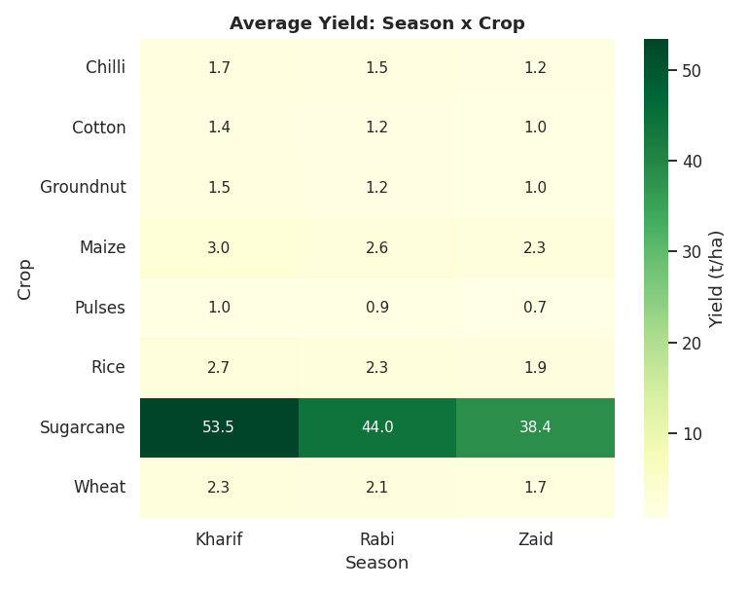
RESULTS - Crop-wise Seasonal Analysis
Sugarcane yields far exceed every other crop in all three seasons - crop choice, not season, is the dominant driver of yield.

Slide 8
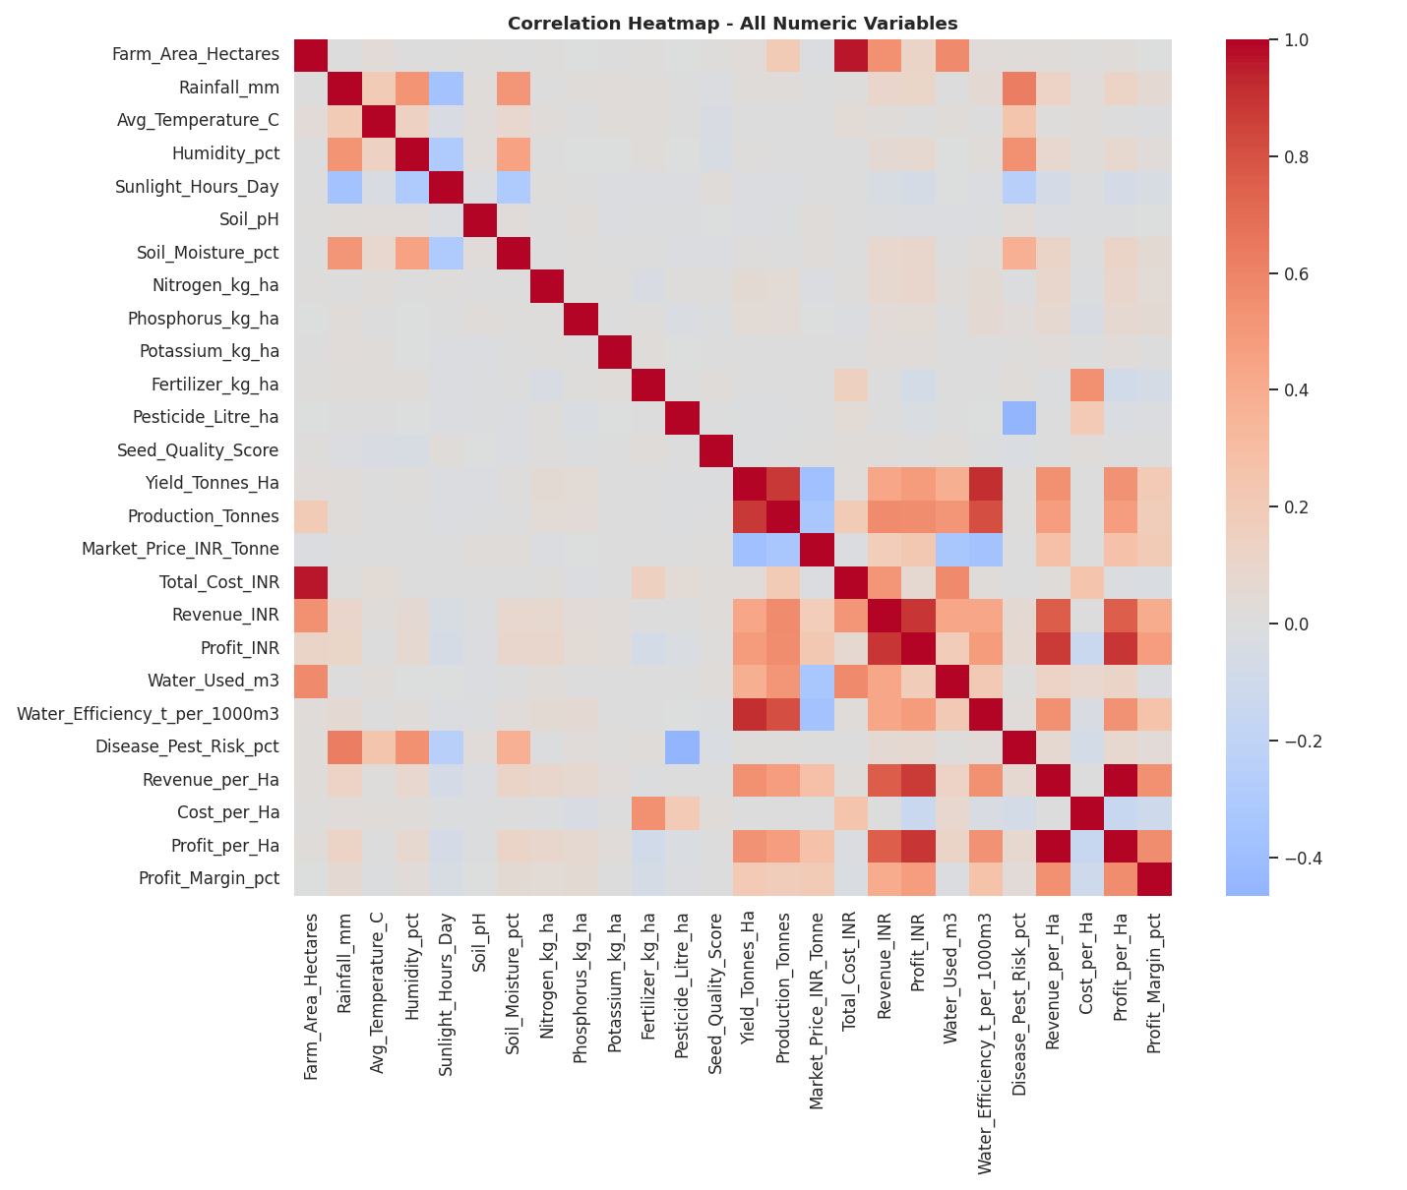
RESULTS - Environmental Relationships
Correlations between environmental variables and outcomes are weak overall (|r| < 0.2) - no single weather variable strongly predicts performance on its own.

Slide 9
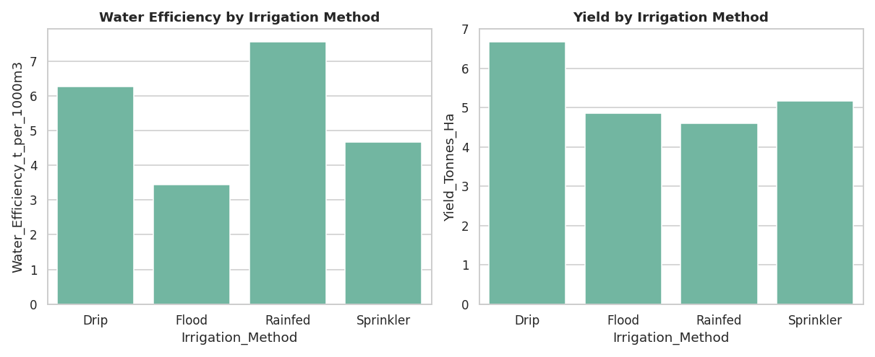
RESULTS - Irrigation & Water Efficiency
Irrigation method is significantly associated with water efficiency (Kruskal-Wallis, p < 0.001); Rainfed and Drip methods are most efficient.

Slide 10
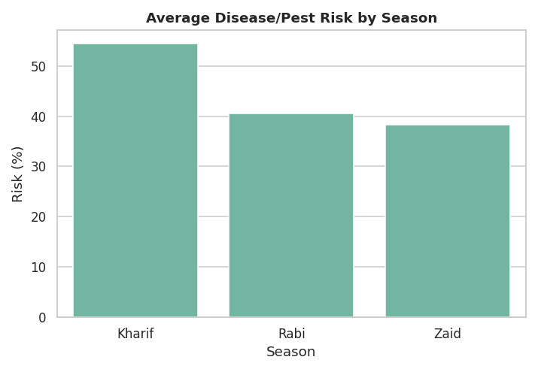
RESULTS - Disease/Pest Risk by Season
Season has a statistically significant effect on yield, profit, water efficiency, and disease/pest risk (Kruskal-Wallis, all p < 0.05, alpha = 0.05).

Slide 11
Future Scope
Extend the dataset to a multi-year panel to separate season effects from year-to-year weather variability
Collect a verified State-District geographic mapping to enable true district-level regional analysis
Capture additional agronomic variables (soil type, sowing date, pest incident records) to improve yield-model accuracy
Apply crop-specific regression or machine-learning models instead of one pooled model, given how strongly yield scale differs by crop
Build an interactive dashboard for real-time seasonal planning by state/crop

Slide 12
GitHub Link
https://github.com/MuthumenenM/Seasonal-Agriculture-Performance-Analysis

Slide 13

VOIS Course completion certificate - Course name- Data Visualization

Slide 14
Thank you
Muthumenen M
github.com/MuthumenenM/Seasonal-Agriculture-Performance-Analysis
.
.

